Slide 1
Project Presentation of Industry Oriented Hands on Experience (22CS422)
On
CODE-CRAFT
Shitij Kalia (2210992300)
Nikhil Kaushal (2210991980)
Nikhil (2210991977)
Shashi Kumar (2210992289)
Supervised By
Mrs. Preeti Saini
Department of Computer Science and Engineering,
Chitkara University, Punjab

Slide 2
CODE_CRAFT USING MERN STACK

Slide 3
ABSTRACT
As the name specifies, “CODE-CRAFT” is software developed for managing online coding practice, learning content, project submissions, and collaboration between students and mentors. In modern technical education, students need a single platform where they can learn programming concepts, solve coding problems, submit projects, and receive feedback quickly. Manual tracking through files, messages, or spreadsheets creates delays, data inconsistency, and limited visibility of progress.
Identification of drawbacks in the existing manual process leads to the design of a computerized system that is more user friendly, secure, and GUI oriented. The platform improves efficiency, reduces repeated work, and keeps coding activity, submissions, and evaluations organized.
• Less human error
• Reduced manual work for mentors and administrators
• High security with role-based access
• Centralised coding records and project submissions
• Easy profile, course, and problem updating
• Quick feedback and performance tracking
• Backup data can be generated easily

Slide 4
INTRODUCTION
Code-Craft has two major modules i.e. Admin and User/Student.
Admin Panel
• Admin Login – Admin can login through a secure login form.
• Admin Profile – Admin can manage profile and change password.
• Courses – Admin can add, edit, and delete programming courses.
• Problems – Admin can create coding questions with test cases.
• Users – Admin can add student profiles and assign batches/courses.
• Manage Submissions – Admin can review code submissions and scores.
• Discussion & Feedback – Admin can view issues, discussions, and student feedback.
• Forgot Password – Admin can retrieve account access through recovery

Slide 5
User Panel
• User Registration – User can register through the registration form.
• User Login – User can login through login form.
• Forgot Password – User can retrieve password through recovery link.
• User Dashboard – User can view assigned courses, problems, and progress.
• User Profile – User can manage their own profile.
• Practice Problems – The user can write, run, and submit code.
• Project Submission – The user can upload project details and repository link.
• Submission History – The user can check submitted code, result, and status.
• Discussion Forum – Users can ask doubts and reply to classmates.
• Feedback – The user can give feedback for courses and the platform.
• Change Password – User can change their own password.
• Access Log – User can view last login details.

Slide 6
SYSTEM ENVIRONMENT
Hardware Configuration
• Intel i3 / Ryzen 3 processor or above
• 4 GB RAM or above
• 100 GB available storage
• 1366 × 768 resolution color monitor
• Stable internet connection
Software Configuration
• OS: Windows 10 / Linux / macOS
• Frontend: React.js, HTML, CSS, JavaScript
• Backend: Node.js and Express.js
• Database: MongoDB
• Tools: VS Code, Git, Postman, npm

Slide 7
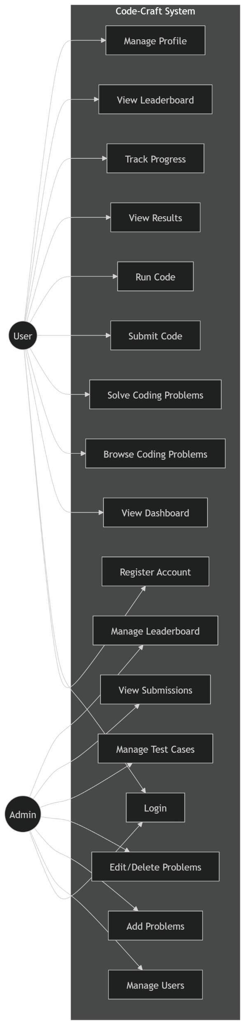
Use Case Diagram

Slide 8
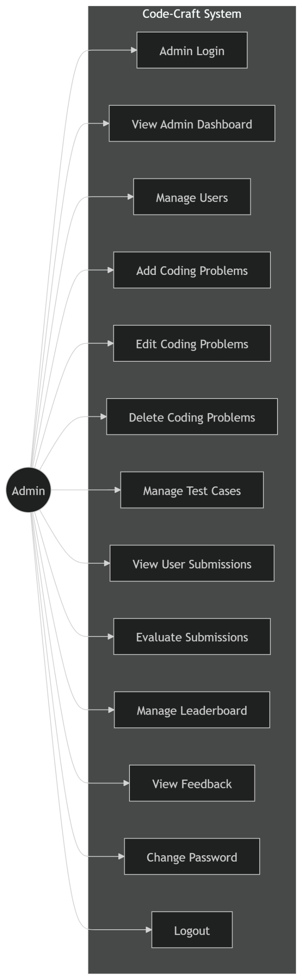

Slide 9
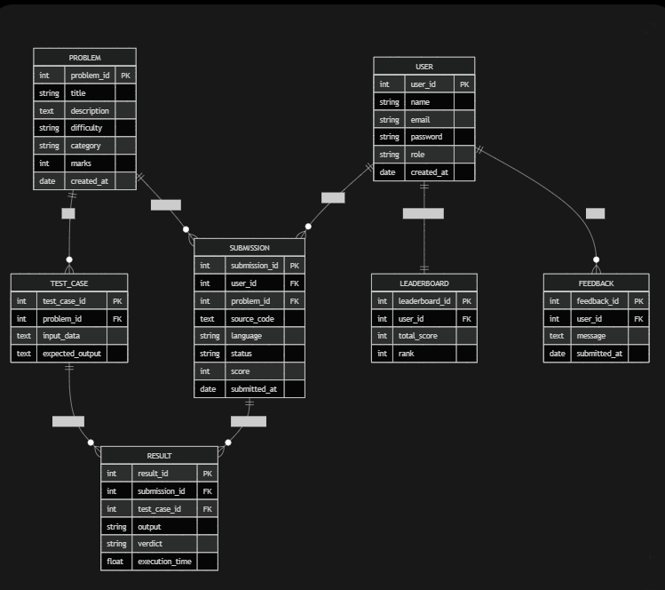
ER Diagram

Slide 10
DATABASE DESIGN
The data in Code-Craft has to be stored and retrieved from a database. Designing the database is a part of system design. Data elements and data structures to be stored are identified at the analysis stage and structured to support quick retrieval, minimum redundancy, and secure access.
A database is a collection of interrelated data stored with minimum duplication to serve many users quickly and efficiently. Relationships are established between users, courses, coding problems, submissions, projects, feedback, and discussions. Normalization is used to maintain internal consistency and reduce chances of data inconsistency. MongoDB has been selected for flexible document storage and fast development of the relevant collections.

Slide 11
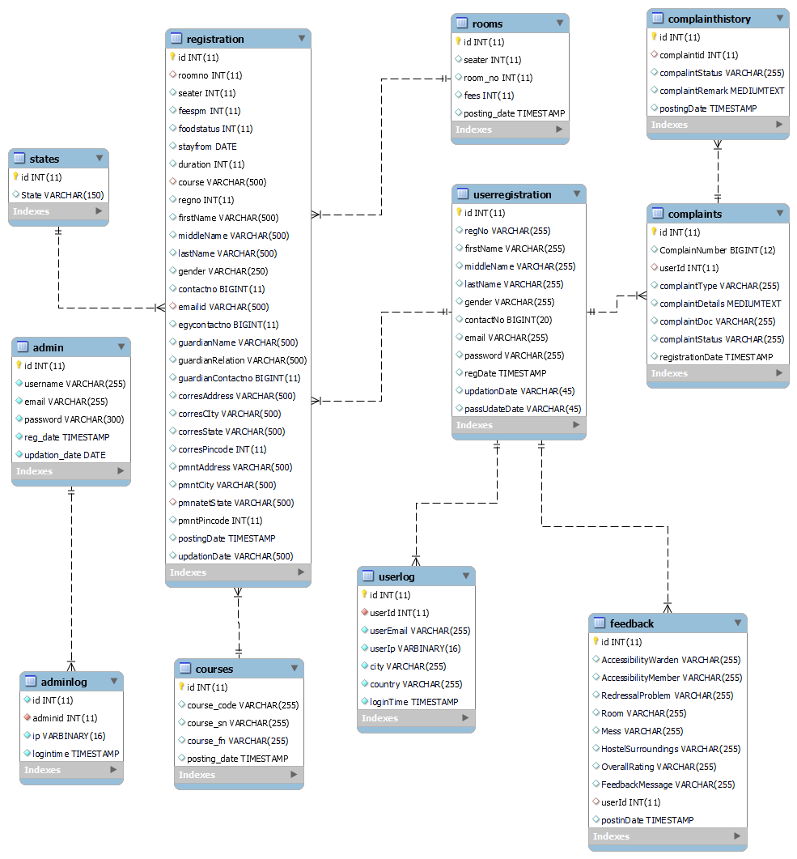
Notes:
Database Table Relationship

Slide 12
Data Flow Diagram (DFD)
A Data Flow Diagram (DFD) is a graphical representation of the flow of data through an information system. A DFD represents how input data is transformed into useful output through different processes. In Code-Craft, users enter registration data, code, project details, doubts, and feedback. The system validates this information, stores it in the database, and generates output such as results, reports, submission status, and feedback records.

Slide 13
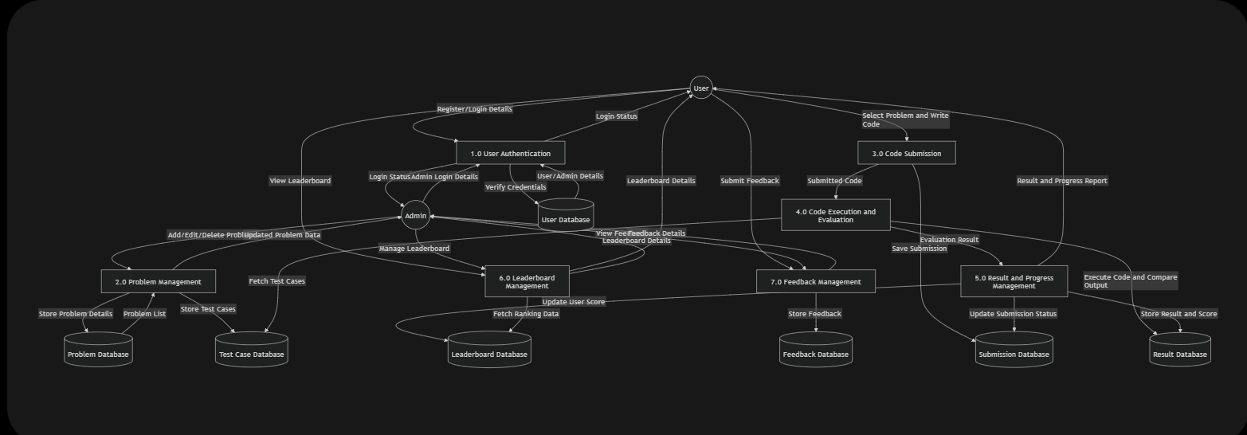

Slide 14
SYSTEM TESTING
System testing is the stage of implementation aimed at ensuring that the system works accurately and efficiently before live operation begins. Testing is the process of executing the program with the intention of finding errors, missing operations, and verifying whether objectives and user requirements are satisfied. The ultimate aim is quality assurance.
Tests are carried out and the results are compared with the expected outcomes. In case of erroneous results, debugging is performed. A detailed test plan is prepared for each module. The main tests performed in Code-Craft are unit testing, integration testing, system testing, and user acceptance testing.

Slide 15
CONCLUSION
To conclude the description about the project: Code-Craft, developed using the MERN stack, is based on user requirements and the analysis of existing manual learning and submission systems, with flexibility for future enhancement.
The expanded functionality of modern software requires an organized approach toward software development. Code-Craft is designed for students, mentors, and administrators who want to manage coding practice, learning content, project submissions, discussions, and feedback in one place. It reduces manual effort, improves record keeping, and provides a user-friendly GUI for efficient interaction.
The system can be enhanced in the future by adding AI code suggestions, plagiarism checking, live contests, automated certificates, and cloud deployment with scalable infrastructure.

Slide 16
BIBILIOGRAPHY
• www.w3schools.com
• developer.mozilla.org
• react.dev
• nodejs.org
• expressjs.com
• www.mongodb.com
• www.geeksforgeeks.org
• www.javatpoint.com

Slide 17
Thank You

